Slide 1
CEGE0096: Geospatial Programming
Lecture 2: Python and Version Control
Dr. Aldo Lipani

Slide 2
Python II

Slide 3
Our Python (Imperative) Journey
Types
Operators
Variables
Simple I/O
Branching
Loops
Functions
Program Planning
Tuples
Lists
Sets
Dictionaries
Strings
Files
Covered in the 1st Lecture

Slide 4
Review Exercise 1
Write a program that requests the user to input a temperature in degree Celsius and prints out a suitable message according to the temperature state below:
“Freezing” when the temperature is below zero;
“Very cold” when it’s between 0 and 10 (not included);
“Cold” when it’s between 10 and 20 (not included);
“Normal” when it’s between 20 and 30 (not included);
“Hot” when it’s between 30 and 40 (not included);
“Very hot” when it’s above 40.
You are allowed to use variables, operators and if statements.
Function reminder:
input('message') prints the message and waits the user for an input
float to convert strings to floating-point numbers
Notes:
3

Slide 5
Solution
print('Temperature to Perceived Temperature Converter (0.1)') temp = input('What temperature is outside? ') # This returns a string temp = float(temp) # This converts it to a float perceived_temp = '' if temp < 0: perceived_temp = 'freezing' elif temp < 10: perceived_temp = 'very cold' elif temp < 20: perceived_temp = 'cold' elif temp < 30: perceived_temp = 'normal' elif temp < 40: perceived_temp = 'hot' else: perceived_temp = 'very hot' print('Your temperature today is', perceived_temp)
Notes:
4

Slide 6
Review Exercise 2
Write a program that ask the user for 3 angles in degrees and checks, if possible, which triangle you can build with them:
Equilateral triangles have all angles equal;
Isosceles triangles have 2 angles equal;
Scalene triangles have all of them are different.
Rules are the same of the previous exercise.
Notes:
5

Slide 7
Solution
print('Angles Checkers for Triangles (0.1)') angle_1 = float(input('1st angle: ')) angle_2 = float(input('2nd angle: ')) angle_3 = float(input('3rd angle: ')) if angle_1 + angle_2 + angle_3 != 180: print("You can't build any triangle out of these angles!!!") elif angle_1 == angle_2 and angle_2 == angle_3: print('You can build an equilateral triangle') elif angle_1 == angle_2 or angle_2 == angle_3 or angle_3 == angle_1: print('You can build an isosceles triangle') else: print('You can build a scalene triangle')
Notes:
6

Slide 8
So far
Can you write a program that prints a number from 1 to 5?
Yes!
print(1) print(2) print(3) print(4) print(5) Can you write a program that prints a number from 1 to n?
Umh!
Or print(1, 2, 3, 4, 5)

Slide 9
While Loop
A while loop repeats the code in its block while a condition is verified.
It behaves like an if because the block is executed only if the condition is verified. However, unlike the if the while loop repeats the block.
while condition:
print('hello')
Will this while loop terminate?
If the condition is not invalidated by the code in the block of the loop, this program will never terminate.
if condition: print('hello')

Slide 10
For Loop
A for loop repeats the code in its block for a prefixed number of times.
It is usually used together with a range function. This function returns a sequence of numbers starting from 0 that is as long as the integer passed as a parameter.
for n in range(5):
print('hello')
Will this for loop terminate?
Yes, for loops (almost) always terminate!

Slide 11
While vs. For Loops
The while loop is more flexible than the for loop.
When you know, before the loop starts, how many times the loop needs to repeat a block, then you should use a for loop. Use a while loop otherwise.
For example, you can write a while loop that behaves like a for:
n = 0 while n < 5: print(n) n = n + 1
Which one would you prefer in this case?
for n in range(5): print(n)

Slide 12
While vs. For Loop (II)
Which one would you prefer when you need…
... to print the letters of a string?
… to compute the average of 5 numbers?
… to compute the average of a user generate sequence of numbers until a “stop” is inputted?
… to iterate over the days of the week?
… to keep asking a user to generate numbers as long as their sum is equal to 100?
for
for
while
for
while

Slide 13
Breaking out of a Loop
Sometimes you may need to break out of a for (or while) loop even if the prefixed number of iterations has not completed (or if the condition is still true).
To do this you could use the break statement
for n in range(5): if n == 3: break print(n) The use of a break is discouraged because it can cause great confusion when reading the code. If you can avoid it, avoid it!
for n in range(3): print(n)

Slide 14
Continuing a Loop
A break statement “jumps out” of the loop.
A complementary statement is continue.
This statement allows you to jump to the end of the loop skipping the instructions after the continue statement.
for n in range(5):
if n == 3: continue
print(n)
To be used as often as the break statement: almost never!
for n in range(5): if n != 3: print(n)

Slide 15
So far
You now know the basics of Python to solve any problem you may be faced with.
For example, can you count the number of ‘h’s in a string? Sure!
string = 'Hello, World!'
count = 0
n = len(string) for i in range(n): if string[i] == 'h' or string[i] == 'H': count = count + 1 print(count)
What if you need to perform this same counting multiple times in your program?
Solution: Copy and paste the same code wherever you need it!
GOOD Solution: Make a function!
BAD

Slide 16
Functions
You can define functions when you need code that needs to be used multiple times in your program.
Functions avoid repetitions and make the code reusable.
You have already seen and used many of them like: str, int, float, range, print and input.
You can define a new function in any block with an arbitrary number of parameters.
def sum(a, b, c): return a + b + c
The return statement is used to indicate what the function should return as an output.
return is optional -- if you don’t specify return the function won’t return anything. This does not mean that such a function is useless, e.g. print does not return anything. But if specified, use only one at the end.
You can name a function as you wish, following the same conventions and restrictions you have for variables.

Slide 17
Functions (II)
You can make optional the specification of some parameters by using default values:
def sum(a, b, c = 0): return a + b + c
In this way, the following two function calls are allowed:
sum(1, 2) sum(1, 2, 3)
You can only specify default values starting from the right-most parameter, e.g., this is not allowed: def sum(a, b = 0, c)

Slide 18
Variables (II) - Scope
The scope of a variable refers to its visibility. A variable is visible when you can access it.
Variables defined within functions are private to the functions. While, variables defined outside functions may be visible within these functions.
a = 10 def foo(): a = 5 print(a) foo() print(a)
What does this code print?
Where is this function visible?
(Same rules apply to functions.)
a = 10 def foo(): def bar(): print(a) a = 5 bar() print(a) foo() print(a)
And, this one?

Slide 19
Example: A Function for Counting Hs
Original version:
string = 'Hello, World!'
count = 0
n = len(string) for i in range(n): if string[i] == 'h' or string[i] == 'H': count = count + 1 print(count)
Function version:
def count_hs(string): count = 0 n = len(string) for i in range(n): if string[i] == 'h' or string[i] == 'H': count = count + 1 return count
You can use this function like this:
count_hs('Hello, World!')
count_hs('I'm another string with two more hs!')

Slide 20
Program Planning
Python programs are usually wrapped into a main function:
def main():
print('Hello, World!') if __name__ == '__main__': main()
The if statement is true only if the script is called using a python interpreter, e.g., like this:
$ python hello_world.py
where the file hello_world.py contains the program above.

Slide 21
PEP8: Style Guide for Python Code
PEP stands for Python Enhancement Proposals.
The PEP8 document gives coding conventions for the Python code comprising the standard library in the main Python distribution.
Use 4 spaces per indentation level.
Surround top-level function definitions with two blank lines.
' strings and " strings are the same. This PEP does not make a recommendation for this. Pick a rule and stick to it. I suggest you the first.
About naming variables and functions:
CamelCase is discouraged in favour of the snake_case.
More details here: https://www.python.org/dev/peps/pep-0008/

Slide 22
Exercise 3 (10 Minutes)
Write a program that keeps requesting the user to input a temperature in degree Celsius and prints out a suitable message according to the temperature state below:
“Freezing” when the temperature is below zero;
“Very cold” when it’s between 0 and 10 (not included);
“Cold” when it’s between 10 and 20 (not included);
“Normal” when it’s between 20 and 30 (not included);
“Hot” when it’s between 30 and 40 (not included);
“Very hot” when it’s above 40.
The program should stop when the user enters a number greater or equal than 100.
You are allowed to use variables, operators, if statements and loops.
Function reminder:
input('message') prints the message and waits the user for an input
float to convert strings to floating-point numbers
Notes:
21

Slide 23
Exercise 4 (10 Minutes)
Write a program that ask the user for 3 angles in degrees and checks, if possible, which triangle you can build with them:
Equilateral triangles have all angles equal;
Isosceles triangles have 2 angles equal;
Scalene triangles have all of them are different.
This check should be done in a function. The function should return the type of triangle.
Rules are the same of the previous exercise.
Notes:
22

Slide 24
Summary
def foo(a):
inp = input('Simon Says type ' + str(a)) while a != int(v): print('Wrong answer!')
inp = input('Simon Says type ' + str(a)) for n in range(5): foo(n)
A function
A while loop
4. The range function
5. A function call
A for loop
Notes:
23

Slide 25
Version Control

Slide 26
Version Control
Making regular backups is important.
We have all made the mistake of spending time and effort writing a document and then losing everything when the computer crashes.
Therefore making at least one back up is important, to recover from sudden death.
How do we avoid this?
Notes:
25

Slide 27
Version Control (II)
But, how many times does your application allow you to undo?
What happens if you close the document and reopen it?
How do you undo a mistake that you made 1 hour ago and keep everything else you have worked on?
Version Control Software (VCS) provides a system for managing changes to a document or collection of documents.
Files can be reinstated to an earlier snapshot.
Notes:
26

Slide 28
Version Control (III)
VCS allows you to have two or more versions of the same program, e.g.:
The version being developed
The version that works (used by the client)
VCS enables two or more people to make changes to the same document. The changes can be later merged.
Notable VCSs are:
Which one should we use? It really depends on your needs.
Git
SVN
Notes:
27

Slide 29
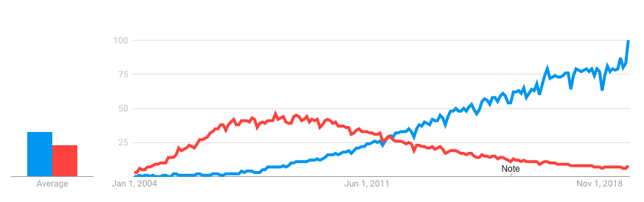
Git
Git is the most widely used VCS
Developed by Linus Torvalds (the creator of Linux)
Git is a distributed VCS (the complete history of your project is in every copy of the repository). While, SVN is centralized.
Git
SVN
Notes:
28

Slide 30
How Does Git Work?
Git can be setup in a directory of your choice. All files (and paths) are managed by Git.
Git creates a hidden sub-directory in which all metadata and snapshots are saved. This is the repository.
Git does not need to be online. All commits are saved in the local directory.
The local repository can be synchronized with a remote repository.
The working directory is a checkout of one version of the project.
The staging area (or index) is a file that stores information about what will go into your next commit.
Notes:
29

Slide 31
The Four States of a File
In Git a file can be in one of the 4 following states:
Untracked: This file is not under VCS;
Modified: You have modified the file but have not committed to your database yet;
Staged: You have marked a modified file in this current version to go into your next commit;
Committed: the data is safely stored in your local database.
Notes:
30

Slide 32
Basic Workflow
You modify files in your working directory.
You selectively stage just those changes you want to be part of your next commit, which adds only those changes to the staging area.
You do a commit, which takes the files as they are in the staging area and stores that snapshot permanently to your Git directory.
Notes:
31

Slide 33
Installing Git in Anaconda
From your geospatial anaconda environment, type:
$ conda install git
And, follow the instructions.
To check if you have correctly installed Git, type:
$ git --version
This should output something like this:
git version 2.20.1
Notes:
32

Slide 34
Getting a Git Repository
You can get a git repository in two ways:
You can take a local directory that is currently not under VCS, and turn it into a Git repository, or;
You can clone an existing Git repository from elsewhere.
To create a git repository in a folder, type:
$ git init
You can always add later a remote repository typing:
$ git remote add origin <url>
To clone an existing repository (it will create the folder for you), type:
$ git clone <url>
Notes:
33

Slide 35
Checking the Status of Your Files
You can check the status of your files by typing:
$ git status
On branch master
Your branch is up-to-date with 'origin/master’.
nothing to commit, working directory clean
This means you have a clean working directory.
If you add a NEW_FILE and type:
$ git status
On branch master
Your branch is up-to-date with 'origin/master’.
Untracked files:
(use "git add <file>..." to include in what will be committed)
NEW_FILE
nothing added to commit but untracked files present (use "git add" to track)
Notes:
34

Slide 36
Tracking New Files
You can add this NEW_FILE to the tracked files (staged) by typing:
$ git add NEW_FILE
Now if you rerun:
$ git status
On branch master
Your branch is up-to-date with 'origin/master’.
Changes to be committed: (use "git reset HEAD <file>..." to unstage)
new file: NEW_FILE
You can tell that the NEW_FILE is staged because it’s under the “Changes to be committed” heading.
You can remove files by using:
$ git rm OLD_FILE
rm 'OLD_FILE'
Notes:
35

Slide 37
Staging Modified Files
If the file was already tracked and you just modified it. And you run:
$ git status
On branch master
Your branch is up-to-date with 'origin/master’.
Changes to be committed:
(use "git reset HEAD <file>..." to unstage)
new file: NEW_FILE Changes not staged for commit:
(use "git add <file>..." to update what will be committed)
(use "git checkout -- <file>..." to discard changes in working directory)
modified: MODIFIED_FILE
The MODIFIED_FILE is not yet staged. It means that if you commit now this file won’t be added to the new snapshot.
To add it to the staged ones, type:
$ git add MODIFIED_FILE
Notes:
36

Slide 38
Committing your Changes
After you have added all the files that you want to commit into your stage area, then you can type:
$ git commit -m "fix: fix for method is_intersecting method of the object Polygon"
[master 463dc4f] fix: fix for method is_intersecting method of the object Polygon
2 files changed, 2 insertions(+)
create mode 100644 geometry.py
To view the commit history, type:
$ git log
commit ca82a6dff817ec66f44342007202690a93763949
Author: Aldo Lipani <aldo.lipani@ucl.ac.uk>
Date: Mon Mar 17 21:52:11 2008 -0700
fix: fix for method is_intersecting method of the object Polygon
commit 085bb3bcb608e1e8451d4b2432f8ecbe6306e7e7
Author: Aldo Lipani <aldo.lipani@ucl.ac.uk>
Date: Sat Mar 15 16:40:33 2008 -0700
feat: added geometry models
Notes:
37

Slide 39
Undoing Things
If you commit to early, you can undo the commit and go back to staged area, typing:
$ git commit --amend
If you want to unstage a file
$ git reset HEAD FILE_NAME
To revert a file to a previous version type:
$ git checkout -- FILE_NAME
Notes:
38

Slide 40
Branching and Merging
Let’s imagine you are working on a project. Create a branch for a new feature you are working on.
Or, let’s imagine you are working on a project in a team. Create a branch for a new feature you are working on.
At this stage, you’ll receive a call that another issue is critical, and you need a hotfix.
Notes:
39

Slide 41
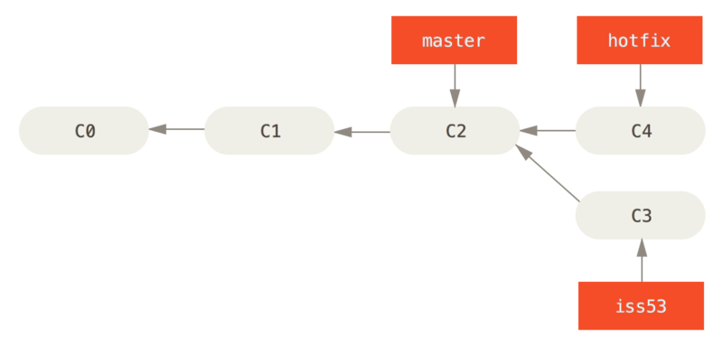
Branching and Merging (II)
Then you’ll do the following:
Switch to your production branch;
Create a branch to add the hotfix;
After it’s tested, merge the hotfix branch, and push to production;
Switch back to the branch you were working on.
Sometimes you may skip the creation of this branch.
Notes:
40

Slide 42
Branching
You need branching:
To get multiple different contexts: adding feature, experiment etc.
To work as a team on the same project
To create a new branch:
$ git branch your-branch-name
To delete an existing branch:
$ git branch –d your-branch-name

Slide 43
Branching (II)
To switch from branch a to branch b:
$ git checkout b
To be able to switch branches, there cannot be any uncommitted changes
on branch a!
To switch to a without committing the current changes on branch b:
$ git stash
$ git checkout a
To switch back to b from a and re-bring current changes on branch b:
$ git checkout b
$ git pop

Slide 44
Merging
Once you are done with a branch you can merge it. Let’s merge b into a.
We first go to a:
$ git checkout a
Then we merge them:
$ git merge b
Updating f42c376..3a0874c
Fast-forward
geometry.py | 2 ++
1 file changed, 2 insertions(+)
Finally you can delete b:
$ git branch –d b

Slide 45
Working with Remote
To get data from the remote you can run
$ git fetch origin
This command goes out to the remote project and pulls down all the data from the remote project that you don’t have yet.
To also update your working directory use pull:
$ git pull origin
When you have your project at a point that you want to share, you can push it to the remote:
$ git push origin master
Note: This command works only if you have writing access to the repository.
Notes:
44

Slide 46
Ignoring Files (.gitignore)
Sometimes you want to ignore files that you know you will never need to commit.
These files could be OS hidden files, IDE folders, compiled files, etc.
You can ignore them by using a special file called .gitignore (the file name must contain the dot).
You need to create this file.
This file is simply a list file names.
Notes:
45

Slide 47
Git at the End of the Day
Notes:
46

Slide 48
VCS Best Practices
Do not push code that crushes! It will annoy your colleagues to find out (usually in the morning) that the code crashes in a point where it was not supposed to crash.
Write meaningful commit messages!
Start your commit with:
fix: when you are fixing a bug;
feat: when you are introducing a new feature;
BREAKING CHANGE: when you are making change (rare);
Other prefixes are allowed.
Here you find more details: https://www.conventionalcommits.org/en/v1.0.0/
Notes:
47

Slide 49
GitHub
GitHub provides hosting for software development version control using Git.
Do not confuse:
Git -- The VCS;
GitHub -- A repository hosting service.
Git users can use GitHub to host their remote repositories.
Notes:
48

Slide 50
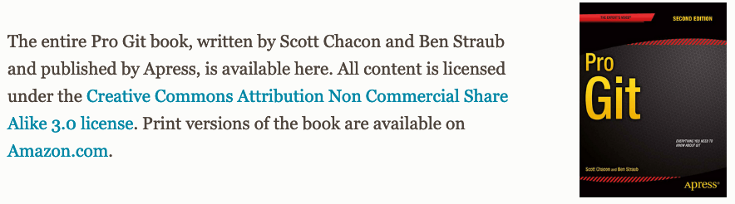
Reference about Git
https://git-scm.com/book/en/v2
Notes:
49

